Slide 1
Oakland Township Fire Department
Strategic Operating Plan
DRAFT
Updated: xx/xx/xxxx

Slide 2
Mission Statement
&
Operating Guidelines

Slide 3
Proposed OTFD Mission Statement*
Our Mission Statement
We will pursue excellence in providing our response to fire, vehicle accidents, hazardous material releases, rescues and medical emergencies in a way that minimizes loss of life, injury, property damage, environmental impact and risks to the public safety members, and to assist residents to deal with those emergencies including the education in fire and medical emergency prepareness.
“Responding with integrity, serving with compassion”
* Approved by the Board of Trustees: xx/xx/xxxx

Slide 4
OTFD Operating Principles*
Our public safety services will be performed with the highest level of integrity, ethics and compassion.
Operate in way that cooperatively leverages “mutual aid” fire and medical emergency services with our surrounding communities.
Measure and publish operational metrics.
Staff with a diverse group of fire and EMS professionals including full-time and “paid on call” members that are capable (physically and skill level) to deliver our stated mission.
Facilities, equipment, operating procedures and training will be in compliance with all Federal, State and local laws.
A continuous improvement process will be used to learn from all activities and improve our fire and EMS services.
Fire Chief will report to the Township Manager and maintain a line of communication with the Board of Trustees to address all operational and financial issues preventing the accomplishment of the stated mission.
* Approved by the Board of Trustees: xx/xx/xxxx

Slide 5
Fire & EMS Standards

Slide 6
Federal / State / ISO
Standards & Protocols
National Fire Protection Association (NFPA)
  NFPA 1710: STANDARD FOR THE ORGANIZATION AND DEPLOYMENT OF FIRE SUPPRESSION OPERATIONS, EMERGENCY MEDICAL OPERATIONS, AND SPECIAL OPERATIONS TO THE PUBLIC BY CAREER FIRE DEPARTMENTS
  NFPA 1720: STANDARD FOR THE ORGANIZATION AND DEPLOYMENT OF FIRE SUPPRESSION OPERATIONS, EMERGENCY MEDICAL OPERATIONS AND SPECIAL OPERATIONS TO THE PUBLIC BY VOLUNTEER FIRE DEPARTMENTS
Oakland County Medical Control Authority
  Section 6.1: AGENCY AND EMS PERSONNEL CRITERIA FOR PARTICIPATION (ALS & BLS)
  Section 6.3: ALTERNATE ALS STAFFING POLICY
  Section 6.18: EMS RESPONSE TIME STANDARDS
ISO Public Protection Classification
  EVALUATES THE CAPACITY OF THE LOCAL FIRE DEPARTMENT TO RESPOND TO AND FIGHT STRUCTURE FIRES.
Michigan Association of Fire Chiefs
  TYPICAL FIRE & EMS RESPONSE TIMES

Slide 7
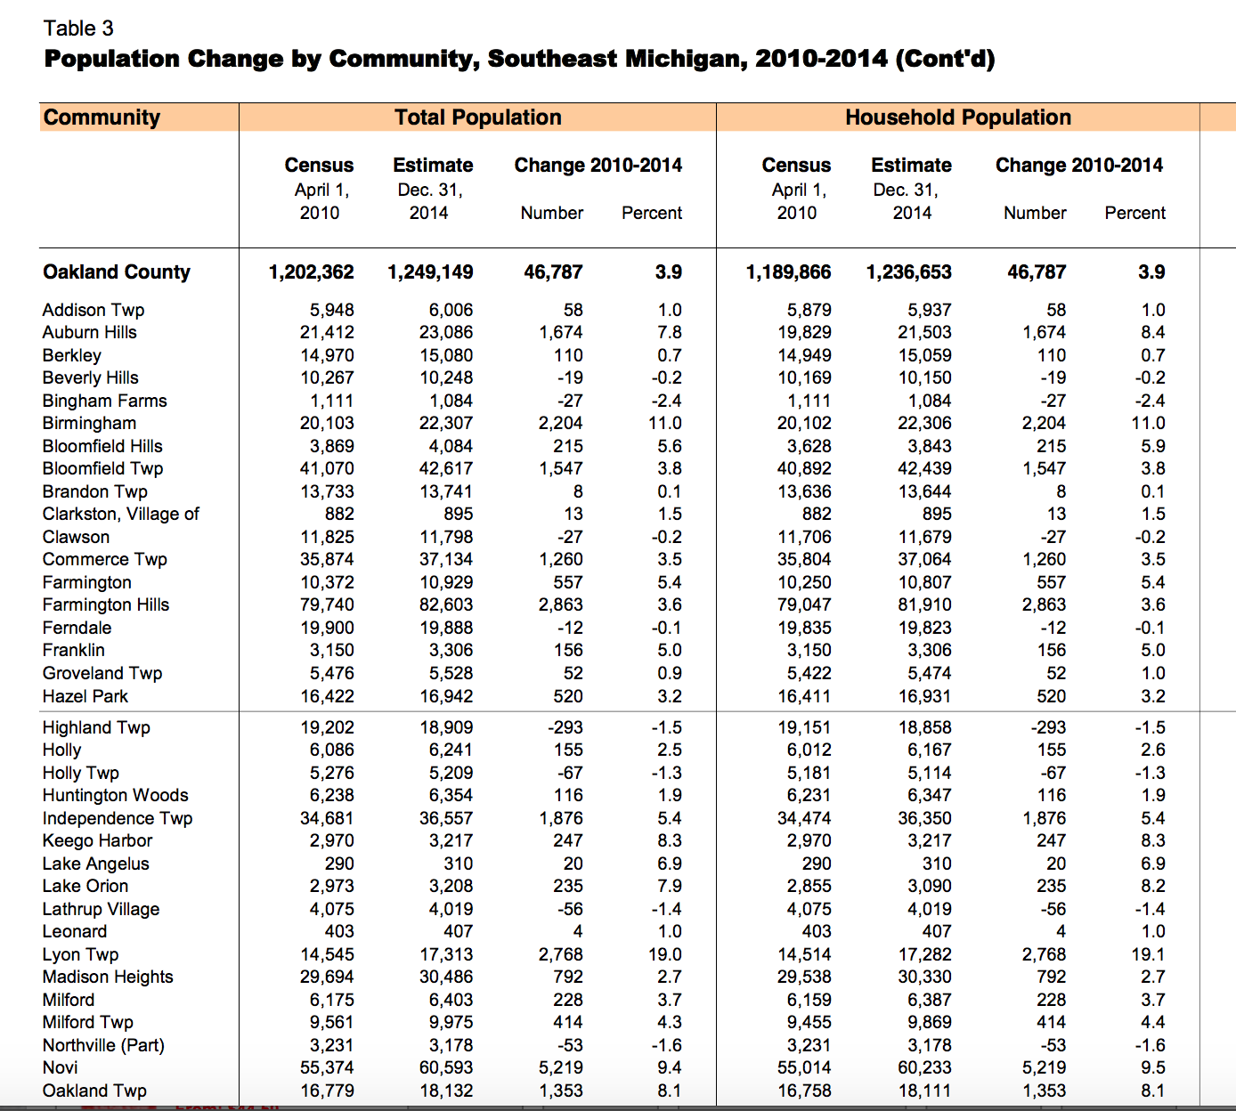
SEMCOG Population Estimates
December 2014
Oakland Twp.
Dec. 2014
492 / sq. mi.
Oakland Twp.
Dec. 2015 Est.
502 / sq. mi.
Oakland Twp.
Apr. 2010
456 / sq. mi.

Slide 8
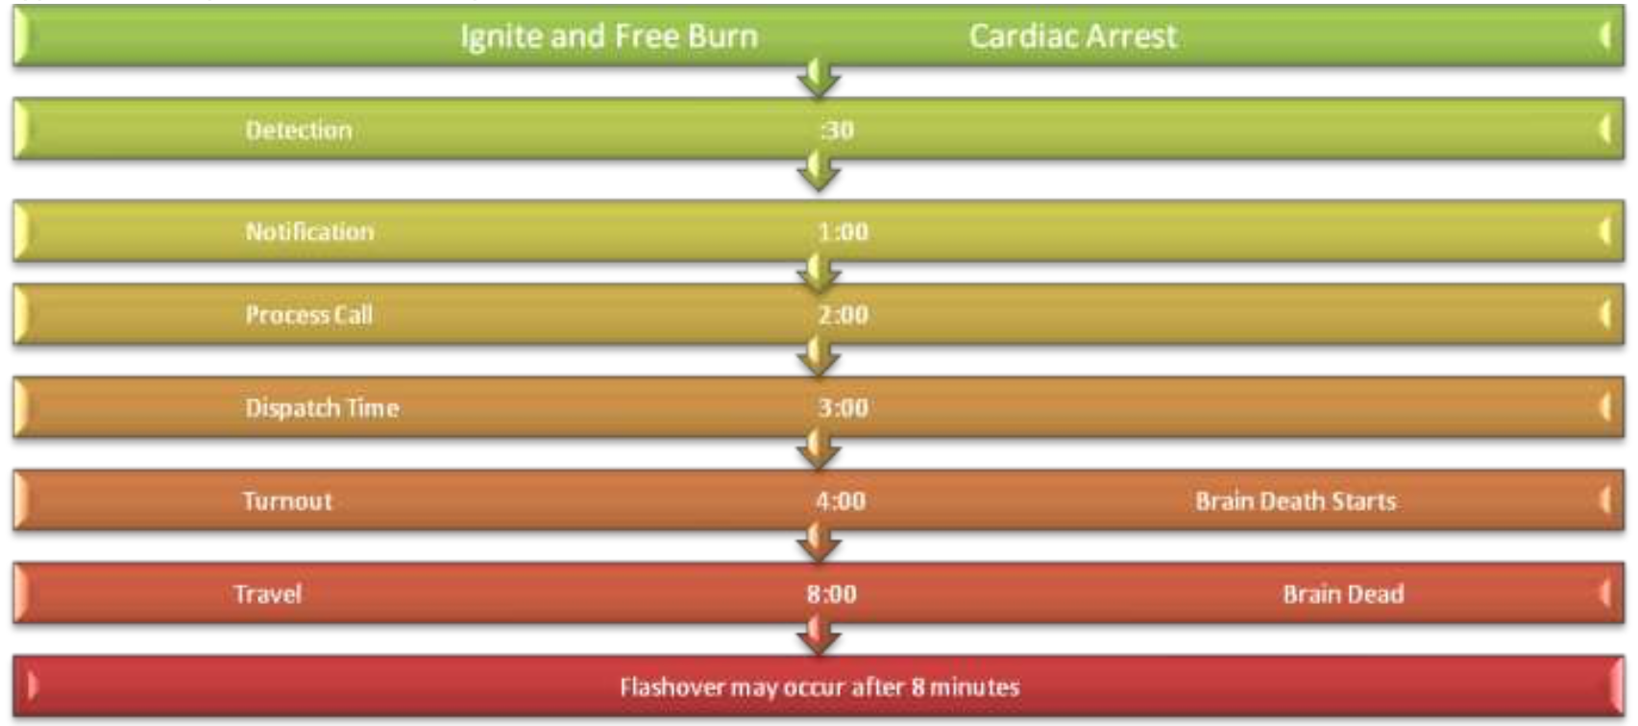
Typical Fire Department Total Response Time*
* Michigan Association of Fire Chiefs

Slide 9
Fire & EMS Standards
 |  | FIRE – NFPA 1710 | FIRE – NFPA 1720 | EMS – OCMCA*
 |  |  | Rural / Suburban | Rural / Suburban
Response Time: - 1st Unit (incl. Turnout) |  | 5.33 mins.** | 14 mins. / 10 mins.*** | 8 mins. / 6 mins.**
Staffing / Unit:
- Fire |  | 4 | 6 / 10
- ALS |  |  |  | 2 Paramedic / Unit Or Alt. Staffing 1 Paramedic + 1 EMT
- BLS (Non-Transport) |  |  |  | 1 EMT / Unit
- BLS (Transport) |  |  |  | 2 EMT / Unit
* OCMCA = Oakland County Medical Authority
** 90% Fractile
*** 80% Fractile
Rural: Less Than 500 people / sq. mi.
Suburban : 500 – 1000 people / sq. mi.

Slide 10
ISO Public Protection Classification
ISO collects information on municipal fire-protection capabilities through on-site assessments. Data includes:
  FIRE-ALARMS AND COMMUNICATIONS SYSTEMS
    alarm dispatch, circuits, radio and telephone facilities, alarm facilities, equipment for power supply, overall system operation
  FIRE DEPARTMENT
    fire station, apparatus, and equipment, pumper tests, aerial ladder and elevating platform test, drills and training, department personnel, firefighter response
  WATER SUPPLY
    water pumping equipment, needed fire flow, hydrant flow tests, hydrant condition, identifying locations of: supply and storage facilities, mains, pressure zones, and valves, hydrants, new streets
Oakland Township ISO Rating = 5 (2004)
  Rating of 5 = Top 25% of all U.S. ratings
  Rating of 4 = Top 10% of all U.S. ratings

Slide 11
Benchmark Analysis

Slide 12
Population Comparisons
* City of Rochester = 13680

Slide 13
Population Comparisons
* City of Rochester = 3572/sq.mi.

Slide 14
Number of Fire Stations

Slide 15
Number of Fire/EMS Full Time Employees
FT = Full Time Employees

Slide 16
Number of Fire/EMS POC’s

Slide 17
Fire/EMS FT Unit Staffing*
1 Station: 2 FT/Unit
1 Station: 1 FT/Unit
1 Station: Unmanned
* All Townships Provide ALS EMS & Transport Service

Slide 18
Benchmark Communities Fire Chief’s Comments
Rationale For 2 FT / Unit Staffing:
  Front load our vehicles with the appropriate staffing
  Prudent staffing models
  NFPA Standards
  Enhance pre-hospital care
  1 medic is limited in providing effective intervening ALS care
  Quicker response time
  Increased run volume
  Command officer on every scene
  Community expectations

Slide 19
Fire/EMS Millage Revenue & Operating Costs
(MM$)
Ave. Benchmark Millage: $2.2MM
Ave. Benchmark Operating Costs: $2.8MM

Slide 20
Fire/EMS Millage Revenue & Operating Costs
Per Capita

Slide 21
Current State

Slide 22
OTFD Current State
Population (2014 SEMCOG Est.): | 18132
Density (Residents/sq.mi.): | 492
Stations: | 2
NFPA / OCMCA Classification: | Rural Suburban
ISO Classification: | 5
Total Runs (2014): Fire/EMS Runs/Other: | 923 26/551/346
Fire/EMS Runs (Priority 1): | 21/528
Fire/EMS Avg. Response Time*: | 15 mins. /6.40 mins.** /10.00 mins.***
Fire/EMS 90% Fractile Response Time: | 20 mins. /9.00 mins.**
Millage Revenue ($MM): | $1.18MM
Operating Budget ($MM): | $1.44MM
* Time Period: 1/1/14 – 6/30/14
** 1st Engine / Alpha Unit Arrival (No Dirt Roads)
*** 2nd Alpha Unit Arrival “Pavement” (No Dirt Roads)

Slide 23
OTFD Current State
Operating Model: | Full Fire & Rescue Capability EMS: Oakland County ALS Provider & Transporter MABAS Mutual Aid
Staffing Model: | Combination FT & POC Unit Staffing: 1 FT / Station, 24/7 + POC Voluntary Response, Both Units Respond to Each Priority Call (If Available…Double Tone 15% – 20%) 1 FT Fire Chief, 1 EMS Coordinator
Funding Model: | Millage (1%) Transport Service Revenue Supplement Operating Costs With General Fund Capital Expense: General Fund
Key Assets: | 4 Engines 2 EMS (2WD) 1 EMS (4WD) 1 Tanker 1 Rescue Truck 3 Utility Pickups 2 Stations

Slide 24
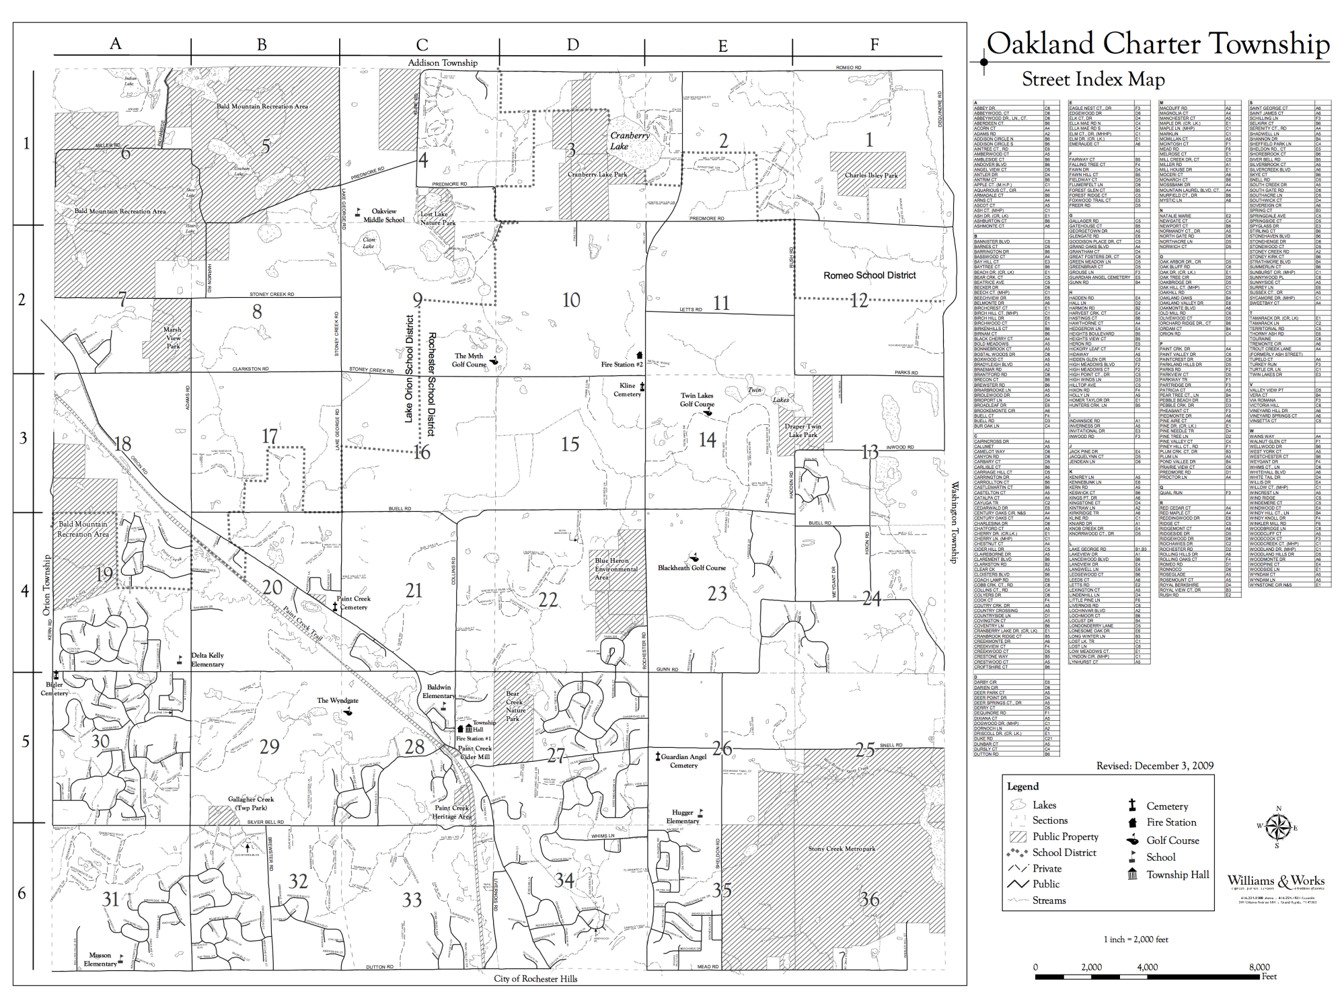
NFPA 1710 Benchmark Travel Distance
4 mins. For 1st Engine Company
Travel Time = 0.65 + 1.7 x Distance Travel
15% of Runs
40% Of Runs

Slide 25
Oakland County Medical Authority
Travel Distance Standard
5 mins. Travel For 1st EMS Response
Travel Time = 0.65 + 1.7 x Distance Travel
15% of Runs
40% Of Runs

Slide 26
Staffing Analysis

Slide 27
Staffing Analysis
Describe Current FT Staffing
Describe Current POC Staffing
  Number of POC & Experience/Training Level
  Include POC response performance
  Turnover Experience
  Operating Costs To Support POC
  POC Key Issues
  Training Requirements
Capabilities Comparison
  1 FT/unit versus 2 FT/unit
Alternative Staffing Options
  Description of alternatives with Pros & Cons

Slide 28
Staffing Capability Comparison
1 FT/ Unit vs. 2 FT/Unit
Provide for a more consistent, appropriate level of patient care.
  When the first arriving ambulance contains two paramedics, all the appropriate equipment can be brought to the patient and effective care can be instituted in a timely fashion.
  Under the current staffing model, the first ambulance to arrive will have one paramedic who will have to carry SOME of the necessary equipment into the house and begin rendering care while waiting for additional personnel to bring the rest of the equipment and to assist in the patient care.
  Due to the distance traveled and condition of many township roads, the second ambulance/paramedic will often arrive 2-3 minutes later.
  Although on-call members are an important and significant part of the system, the inherent inconsistency of response can contribute to delays in providing care. Weekdays, when many members are at work, are particularly challenging.
  In the case of a cardiac arrest, two-person CPR is far more effective than one-person CPR. If that care can be initiated upon the arrival of the first ambulance there is a better chance for a positive patient outcome.
  In the initial phases of CPR there are many Advanced Life procedures that need to be carried out rapidly. Establishing an advanced airway, establishing IV access, interpreting heart rhythms, and administering medications all require a paramedic. When that second paramedic is still 2-3 minutes away, patient care suffers.

Slide 29
Staffing Capability Comparison
1 FT/ Unit vs. 2 FT/Unit
Significantly reduce the time to initiate rescue and fire suppression.
  The minimum manpower requirement to begin fire suppression activities is 5 people. Two people will be in the building, two people will be outside the building for safety/rescue and there will be one scene commander.
  Under the current staffing model the firefighter/paramedic at the station closest to the fire staffs the first-due engine and waits for sufficient on-call members to arrive before responding to the scene. The firefighter/paramedic at the other station responds immediately to the scene to begin scene size-up and await the arrival of the engine. The time it takes to get sufficient manpower and equipment to the scene to begin initial suppression activity can be 15-20 minutes.
  Under the proposed staffing model there would be no need to wait for on-call members. The two fulltime firefighter/paramedics at each station would respond immediately in engines (or one engine, one ambulance) providing four firefighters and an engine at the scene in a timely fashion to begin suppression activity. On-call members would respond to the stations and bring the remaining apparatus to the scene and round out the manpower requirements. The time to initiate this suppression activity would typically be 7-10 minutes.

Slide 30
Staffing Capability Comparison
1 FT/ Unit vs. 2 FT/Unit
The additional staffing would provide for greater safety.
  When responding to a call a single responder is responsible for driving, navigating, and communicating on the radio. Having a second person in the vehicle lets the driver concentrate on driving safely.
  A single employee, working alone in a station, is at risk from injury or medical issues. With nobody to assist, it is possible that an incapacitated member wouldn’t be discovered until the next shift starts work in the morning. There was an instance at this department where a lone member slipped on the ice in the parking lot and was knocked unconscious for a period of time and nobody was aware of it. Fortunately he regained consciousness in a short period of time and was not significantly injured.

Slide 31
Alternative Staffing Options
Current State | Plan A | Plan B | Plan B (Hybrid) | Plan C | Plan D | Plan E
Staff 1 FT / Station, 24/7 | Schedule POC and PT to Staff 2 / Station, M – F, 10:00 – 18:00, | Hire 2 FT’s to Staff 2 / Station, M-F, 10:00 – 18:00, | Plan B + allow all FT’s to respond to calls during non-work hours for overtime pay | Utilize POC and PT to Staff 2 / Station, 24/7 | Hire 3 FT’s to Staff one station with 2 FT’s, Utilize POC and PT to Staff Second Station, 24/7 | Hire 6 FT’s to Staff both stations with 2 FT’s, 24/7
 | Est. $85K / yr. | Est. $150K / yr. | Est. $175K / yr. | Est. $350K / yr. | Est. $500K / yr. | Est. $650K / yr.
Evaluation Criteria
NFPA, OCMCA Standards, Benchmark Communities
Minimum Manpower Availability
  Fire – 5 (Response Time, Search & Rescue)
  EMS – 2 (Response Time, Intervention Efficiency)
  Vehicle Accident – 4 (Response Time, Fire, EMS, Rescue)
Manpower for Double Tones & Multiple Patients
Scene & Station Safety
Unit Navigation Efficiency
Mutual Aid Response Capability
Training Efficiency and Skill Base Capability
Personnel Retention

Slide 32
Future State

Slide 33
OTFD Future State - 2025
 | Current State | Future State
Population (2014 SEMCOG Est.): | 18132 | 19032
Density (Residents/sq.mi.): | 492 | 517
Stations: | 2 | TBD
NFPA / OCMCA Classification: | Rural Suburban | Suburban
ISO Classification: | 5 | TBD
Fire/EMS Runs (Total): | / | TBD
Fire/EMS Runs (Priority 1): | / | TBD
Fire/EMS Avg. Response Time: | / | TBD
Fire/EMS 90% Fractile Response Time: | / | TBD
Millage Revenue ($MM): | $1.18MM | TBD
Operating Budget ($MM): | $1.44MM | TBD

Slide 34
OTFD Future State
 | Current State | Future State
Operating Model: | Full Fire & Rescue Capability EMS: Oakland County ALS Provider & Transporter Member SE Mich. Mutual Aid
Staffing Model: | Combination FT & POC Unit Staffing: 1 FTE Unit 24/7 + POC Voluntary Response, Both Units Respond to Each Priority Call 1 FT Fire Chief, 1 EMS Coordinator
Funding Model: | Millage (1%) Transport Service Revenue Supplement Operating Costs With General Fund Capital Expense: General Fund
Key Assets: | 4 Engines 2 EMS (2WD) 1 EMS (4WD) 1 Tanker 1 Rescue Truck 3 Utility Pickups 2 Stations

Slide 35
Oakland County Medical Authority
Travel Distance Standard
5 mins. Travel For 1st EMS Response
Travel Time = 0.65 + 1.7 x Distance Travel
15% of Runs
40% Of Runs

Slide 36
Key Fire/EMS Issues
Capability of current operating model (1 FT/Unit) to deliver required Fire/EMS response,
  NFPA Fire standards
  OCMA EMS standard for “Rural” and the new “Suburban” classification.
  Currently operating below comparison communities FT staffing levels
Sustainable funding stream to replace aging assets.
Significant loss of Fire/EMS experience forecasted over next 5 – 10 years due to retirements.
Changing demographics / training requirements impact on recruitment/retention of “Paid-On-Call” volunteers.

Slide 37
Strategies To Achieve Future State
Identification of the strategies to address the Key Issues to achieve the Future State.

Slide 38
Alternative Strategies Considered
Description and analysis of the “Alternative Strategies” considered and why preferred strategy was selected and other options rejected.

Slide 39
Capital & Financial Plans

Slide 40
10 Year Capital Plan
Equipment | Purchase Date | Est. Useful Life | Replacement Date | Purchase Amount | Replacement Cost Est. | Replacement Plan
ATV - 1 | 1998 | 10 | 2008 | 9463 | 15000 | 2016
Engine 1-2 | 1998 | 20 - 25 | 2013 | 313351 | 500000 | 2021
Rescue - 2 | 1999 | 15 | 2014 | 216880 | 350000 | 2016
Turnout Gear (12 sets) | 2002 | 10 | 2012 |  | 36000 | 2016
ALS Life Packs (2 Packs) | 2004 | 10 | 2014 |  | 60000 | 2016
Chest Comp. Packs (2) |  |  |  |  | 28000 | 2016
Engine 2-2 | 2002 | 20 - 25 | 2017 | 340000 | 500000 | 2024
Utility - 1 | 2002 | 15 | 2017 | 21511 | 30000 | 2017
Turnout Gear (12 sets) | 2007 | 10 | 2017 |  | 36000 | 2017
Engine 1-1 | 2002 | 20 - 25 | 2017 | 340000 | 500000 | 2025
Alpha 2 | 2013 | 5 | 2018 | 157077 | 160000 | 2018
Engine 2-1 | 2002 | 20 - 25 | 2017 | 340000 | 500000 | 2027
Alpha 1 | 2014 | 5 | 2019 |  | 160000 | 2019
Chief - 1 | 2014 | 5 | 2019 |  | 40000 | 2019

Slide 41
10 Year Capital Plan
Equipment | Purchase Date | Est. Useful Life | Replacement Date | Purchase Amount | Replacement Cost Est. | Replacement Plan
Tanker - 1 | 2002 | 15 | 2017 | 360000 | 600000 | 2020
Utility - 2 | 2005 | 15 | 2020 | 19547 | 30000 | 2020
Grass Fire Unit - 1 | 2002 | 20 | 2022 | 21078 | 300000 | 2022
200 Gal Skid Unit | 2002 | 20 | 2022 | 12000 | 15000 | 2022
Bravo-1 | 2014 | 8 | 2022 |  | 160000 | 2022
SRT | 1998 | 20 | 2018 | 4670 | 5000 | 2023
Turnout Gear (12 sets) | 2015 | 10 | 2025 |  | 36000 | 2025
Safety House Trailer | 2002 | 20 | 2022 | 28975 | 300000 | 2027
Boat - 1 | 2007 | 20 | 2027 | 1453 | 2000 | 2027
Outboard Motor | 2007 | 20 | 2027 | 1710 | 2000 | 2027
Misc. Capital (Annual) |  |  |  |  | 25000

Slide 42
10 Year Capital Plan
* 2015 Dollars

Slide 43
3 Year Operating Budget
High level 3 year Operating Budget projections with “Key Changes” highlighted and the “Drivers” creating the change.
Include a listing of the “Key Assumptions” included in the 3 year plan.

Slide 44
Appendix

Slide 45
Fire & EMS Standards
Detailed Information

Slide 46
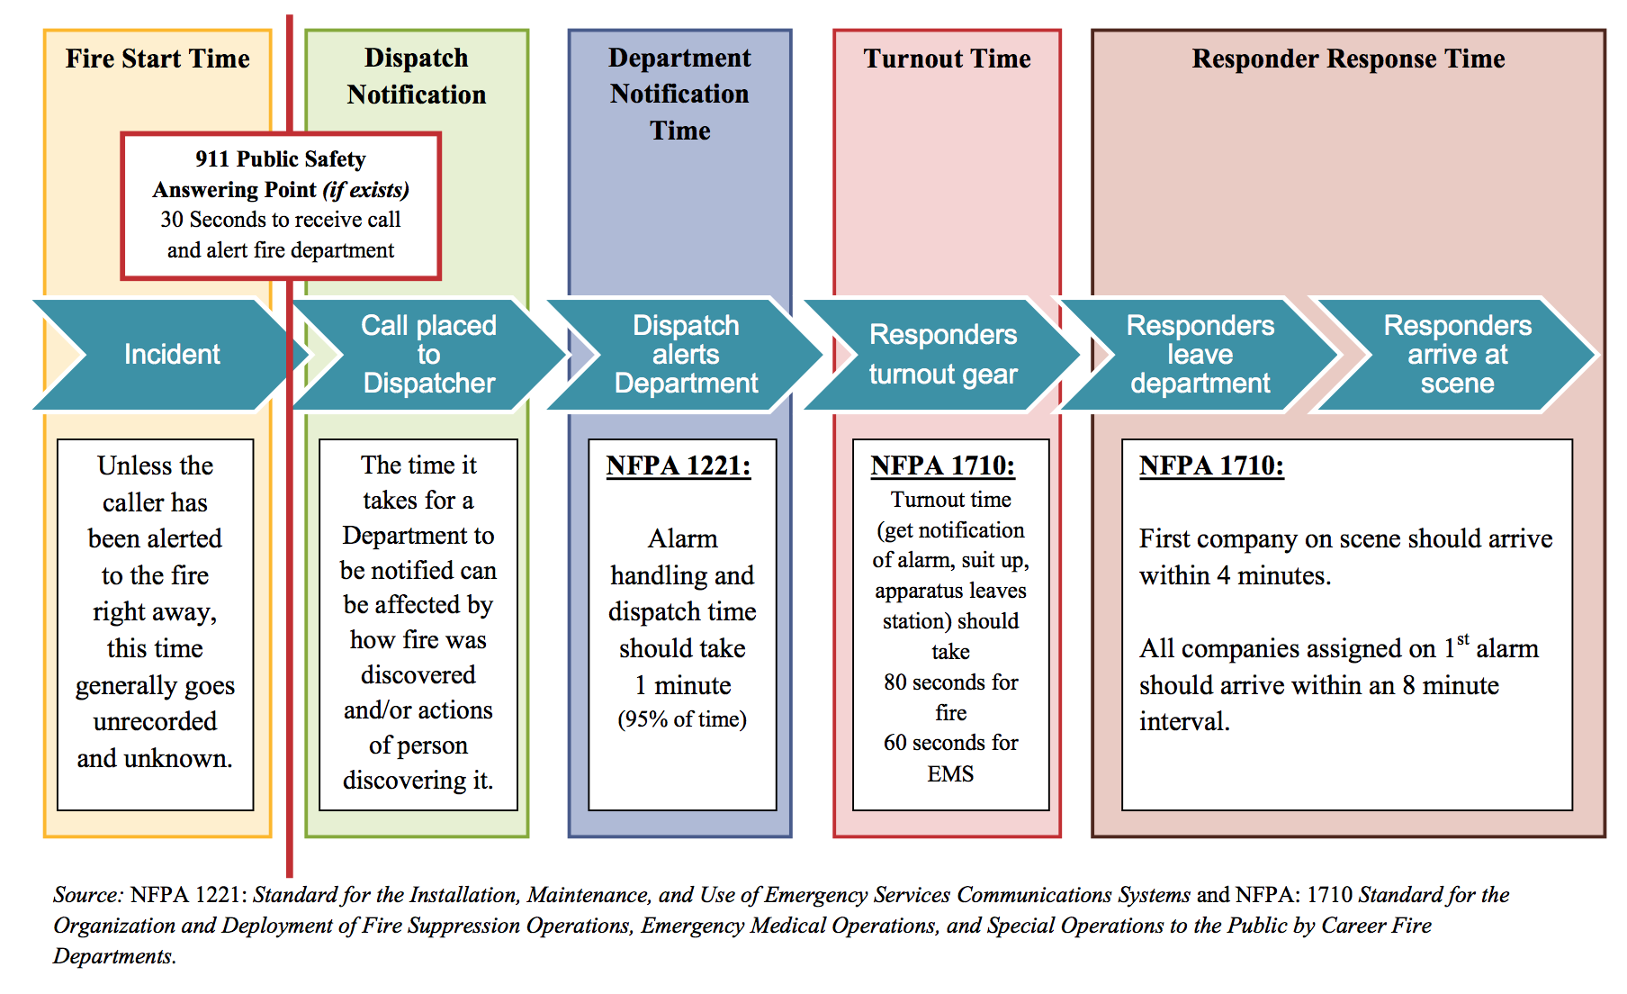
NFPA 1221 and 1710 Recommendations
For Career Fire Fighters

Slide 47
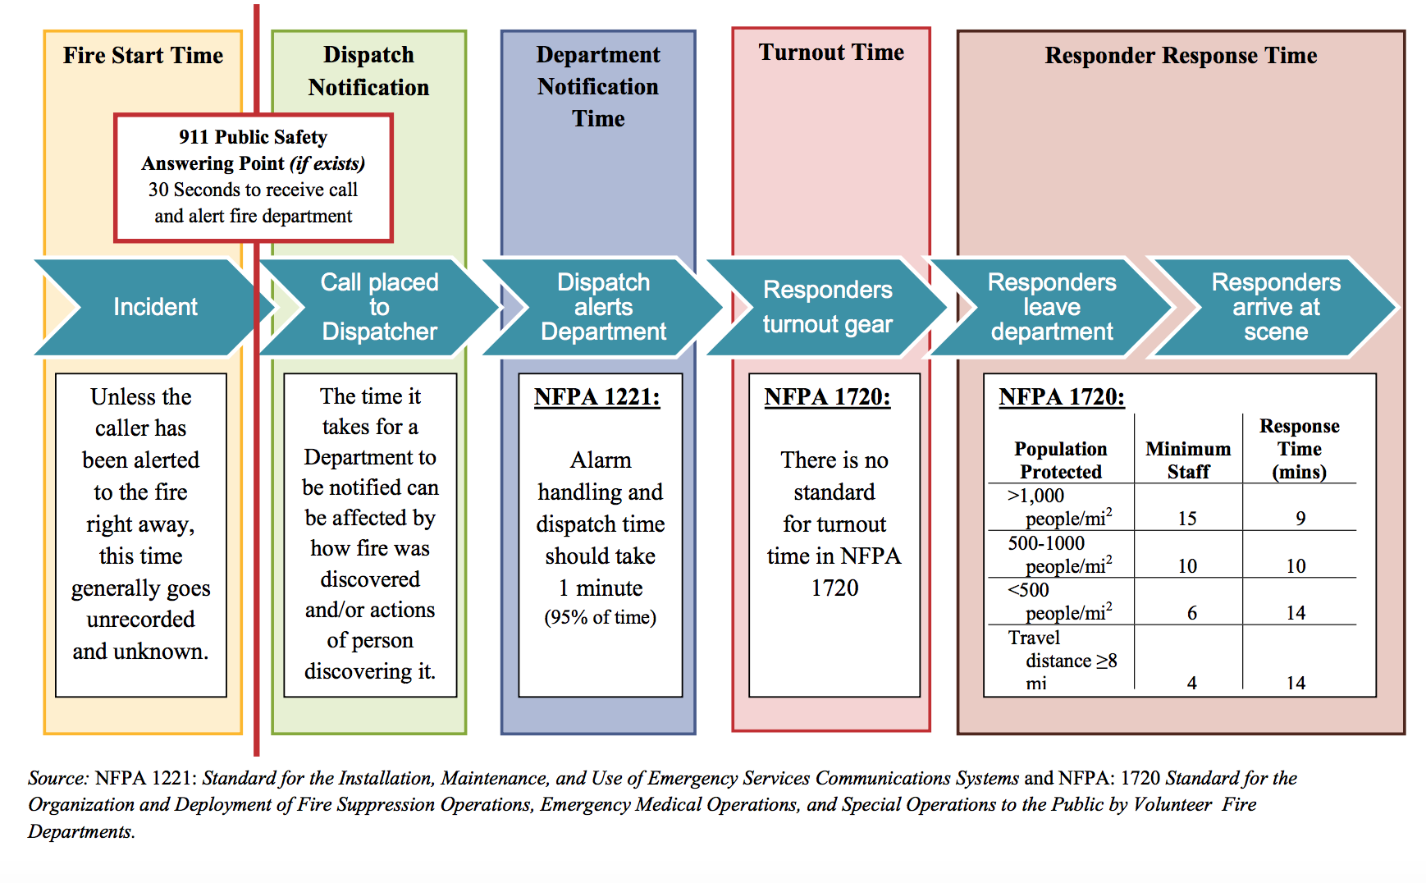
NFPA 1221 and 1720 Recommendations
For Volunteer Fire Fighters

Slide 48
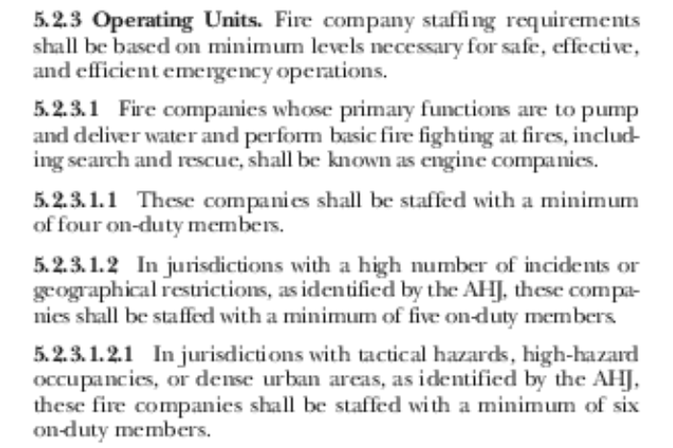
NFPA 1710 Fire Staffing Recommendations

Slide 49
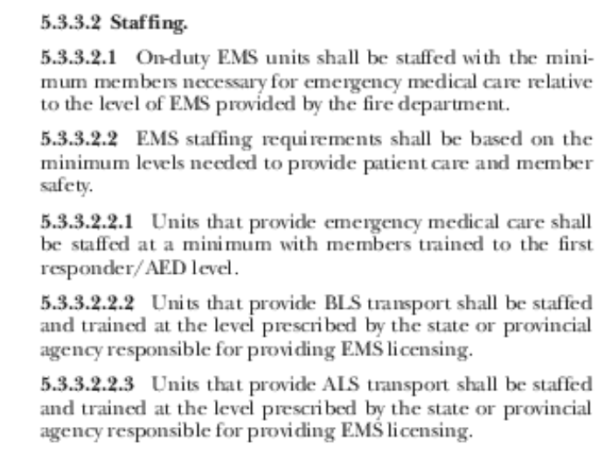
NFPA 1710 EMS Staffing Recommendations

Slide 50
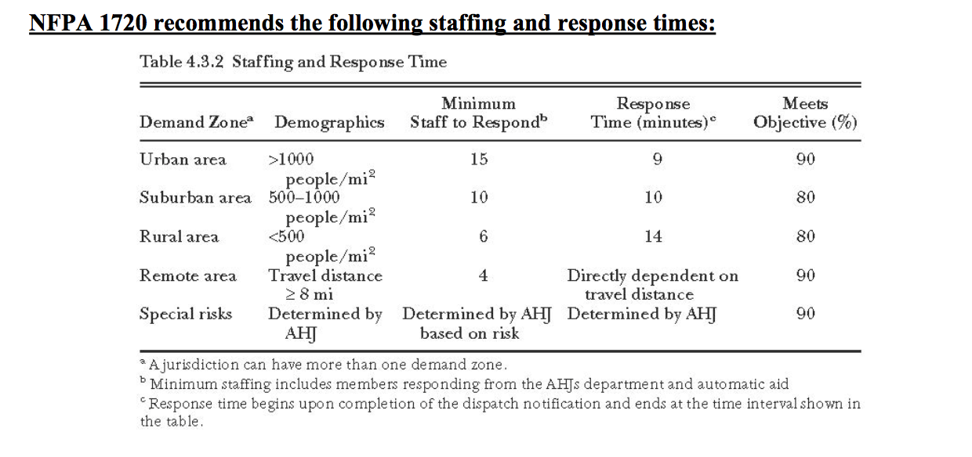
NFPA 1720 – Volunteer Fire Department
*AHJ = Authority Having Jurisdication

Slide 51
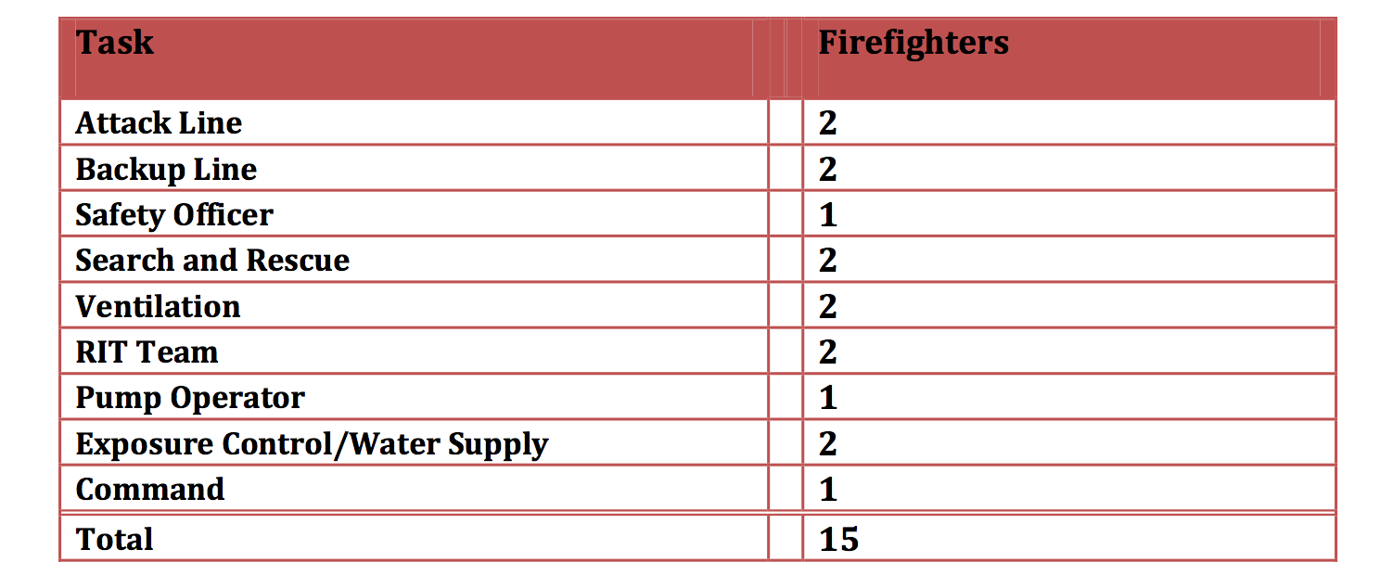
Minimum Fire Scene Staffing Requirements*
* Michigan Association of Fire Chiefs

Slide 52
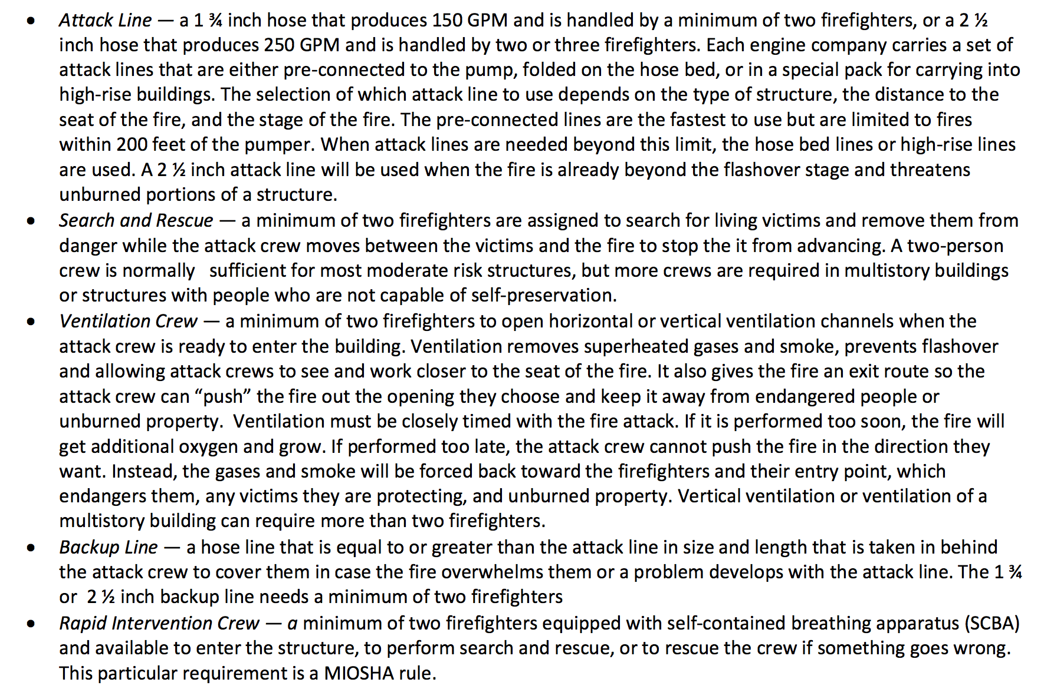
Minimum Fire Scene Staffing Requirements*
* Michigan Association of Fire Chiefs

Slide 53
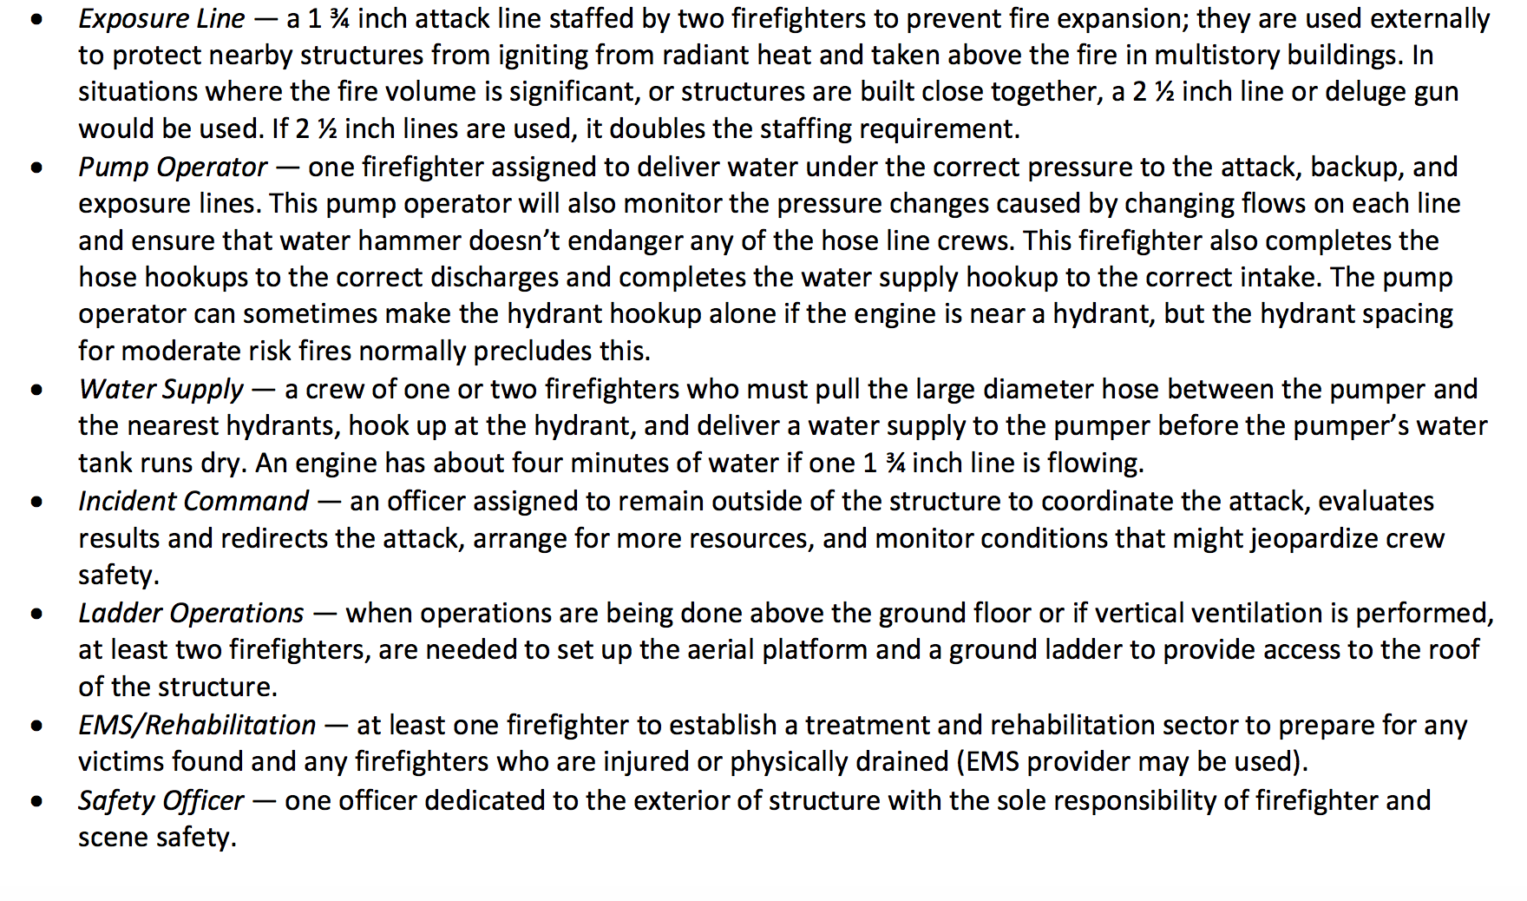
Minimum Fire Scene Staffing Requirements*
* Michigan Association of Fire Chiefs

Slide 54
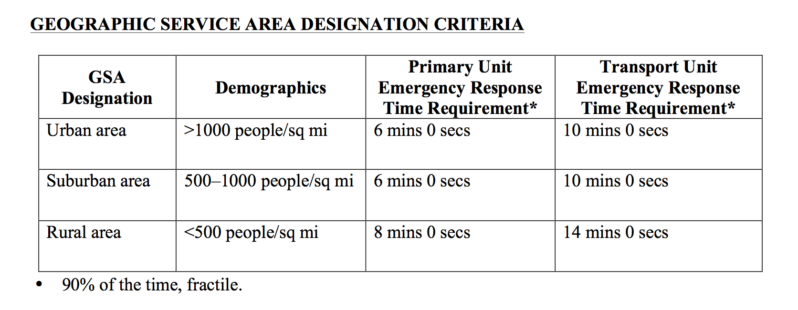
Oakland County Medical Control Authority
System Protocols
EMS Response Time Standards
OTFD currently meets “Rural Area” response time standard, but will not satisfy “Suburban Area” standard under the current operating model.

Slide 55
Oakland County Medical Control Authority
System Protocols
Appendix A: Life Support Agency Letter of Compliance
For ALS Agencies Only
Provide staffing in accordance with the Agency and EMS Personnel Criteria for Participation Policy
A. Provides two paramedics on each licensed ALS unit.
B. Provides one paramedic/one Basic EMT in accordance with the Interim or Alternate Staffing Policy. *
Personnel shall be trained and licensed in accordance with appropriate statutes, rules, and criteria and maintain current ACLS, with recommendations to include a nationally recognized pediatric program.
(See Agency and EMS Criteria for Participation Policy 6-1)
* OTFD currently operates under the Alternate Staffing Policy.

Slide 56
Benchmark Analysis
Data

Slide 57
Township / Municipal Profiles
General Information
 |  | Oakland Township | Auburn Hills | Wash. Township | Oxford | Bruce / Romeo | Brandon Township
Data Year: |  | Semcog 2014 | Semcog 2014 | Semcog 2014 | Semcog 2014 | Semcog 2014 | Semcog 2014
Population |  | 18,132 | 23,086 | 24,518 | 21,069 | 10,468 | 13,741
Square Miles |  | 36.8 | 16.64 | 36.8 | 35.2 | 36.6 | 35.8
Population Density (Ave. Pop. / Sq. Mi.) |  | 492/ Sq. Mi. | 1,387/ Sq. Mi. | 666/Sq. Mi. | 598/ Sq. Mi. | 286/Sq. Mi. | 384/Sq. Mi.
Central Dispatch (Y/N) |  | Yes | No | Hybrid | Yes | Hybrid | Yes
Fire (Self/Contract) |  | Self | Self | Self | Self | Self | Self
EMS (Self/Contract) |  | Self | Self | Self | Self | Self | Self
Mutual Aid Services (Y/N) |  | Yes | Yes | Yes | Yes | Yes | Yes
# of Fire Stations |  | 2 | 3 | 2 | 2 | 3 | 3
# of EMS Stations |  | 0 | 0 | 0 | 0 | 0 | 0

Slide 58
Township / Municipal Profiles
Staffing
 |  | Oakland Township | Auburn Hills | Wash. Township | Oxford | Bruce / Romeo | Brandon Township
Data Year: |  | 2015 | 2015 | 2015 | 2015 | 2015 | 2015
# of FT Fire / EMS |  | 7 |  | 24 | 13 | 12 | 11
# of FT Fire Only |  | 0 |  | 0 | 0 | 0 | 0
# of FT EMS Only |  | 0 |  | 0 | 0 | 0 | 0
# of POC Fire/EMS |  | 19 |  | 8 | 24 | 15 | 28
# of Non Fire / EMS ONLY |  | 3 |  | 0 | 1 | 0 | 0
Fire Chief (Y/N) & (FT/PT) |  | Chief/FT |  | Chief/Ft Asst. C/FT Sec/Disp. FT | Chief/Ft | Chief/FT Sec./FT | Chief/FT Sec./FT

Slide 59
Township / Municipal Profiles
Equipment – Quantity / Age
 |  | Oakland Township | Auburn Hills | Wash. Township | Oxford | Bruce / Romeo | Brandon Township
 |  | # / Age | # / Age | # / Age | # / Age | # / Age | # / Age
# of Engines
# of Ladder Engines
# of Tanker Trucks
# of EMS (BLS)
# of EMS (ALS)
# of EMS (non BLS/ALS)
# of Rescue Units
# of Sp. Response Trailors (SRT)
# of Utility Vehicles
# of Grass Fire Eq.
# of Boats
# of ATV

Slide 60
Township / Municipal Profiles
Equipment – Estimated Replacement Year
 |  | Oakland Township | Auburn Hills | Wash. Township | Oxford | Bruce / Romeo | Brandon Township
 |  | Est. Repl. Yr. | Est. Repl. Yr. | Est. Repl. Yr. | Est. Repl. Yr. | Est. Repl. Yr. | Est. Repl. Yr.
# of Engines
# of Ladder Engines
# of Tanker Trucks
# of EMS (BLS)
# of EMS (ALS)
# of EMS (non BLS/ALS)
# of Rescue Units
# of Sp. Response Trailors (SRT)
# of Utility Vehicles
# of Grass Fire Eq.
# of Boats
# of ATV

Slide 61
Township / Municipal Profiles
Financials
 |  | Oakland Township | Auburn Hills | Wash. Township | Oxford | Bruce / Romeo | Brandon Township
Data Year: |  | 2015 | 2015 | 2015 | 2015 | 2015 | 2015
Fire Millage Rate |  | 1.0 | 1.7604 | 4.34 | 3.5 | 5.53 | 4.3905
Millage Revenue |  | 1,181,320 | 2,618,559 | 3,730,440 | 1,698,121 | 1,551,527 | 1,859,035
Millage Tax Base ($) |  | 1,181,320,000 | 1,487,480,000 | 589,548,387 | 485,177,428 | 280,565,461 | 423,422,161
Operating Costs (ex. Capital Expenditures) |  | 1,444,073 | 3,311,134 | 4,161,744 | 2,692,458 | 2,427,200 | 2,034,370
Cost / Total Runs
Cost / Fire Run
Cost / EMS Run
Total Capital Investment (Gross)
Capital /Total Runs
Capital / Fire Run
Capital / EMS Run
Accrued Capital For Future Expenditures

Slide 62
Township / Municipal Profiles
Peformance Metrics - Fire
 |  | Oakland Township | Auburn Hills | Wash. Township | Oxford | Bruce / Romeo | Brandon Township
Data Year:
# of Fire Runs (Total)
# of Fire Runs (Emergency)
# of Fire Runs (non Emergency)
Mutual Aid Runs (Aid Requested)
Mutual Aid Runs (Aid Provided)
All Other Fire Responses
# of Fire Runs / 1000 Population

Slide 63
Township / Municipal Profiles
Peformance Metrics – Fire
Response Time
 |  | Oakland Township | Auburn Hills | Wash. Township | Oxford | Bruce / Romeo | Brandon Township
Data Year:
Ave. Turnout Time (sec.)
Ave. Travel Time (sec.)
Ave. Total Response Time
Response Time Goal 1st Engine Full Team
% of Times Less Than “x” Minutes
% of Times More Than “x” Minutes
% of Fires Controlled (No Spread After 1st Engine Arrival)

Slide 64
Township / Municipal Profiles
Peformance Metrics - EMS
 |  | Oakland Township | Auburn Hills | Wash. Township | Oxford | Bruce / Romeo | Brandon Township
Data Year:
# of EMS Runs (Total)
# of EMS Runs ( Fire Emergency)
# of EMS Runs (Medical Emergency)
# of EMS Runs (non Emergency)
Mutual Aid Runs (Aid Requested)
Mutual Aid Runs (Aid Provided)
# of EMS Runs / 1000 Population

Slide 65
Township / Municipal Profiles
Peformance Metrics – EMS
Response Time
 |  | Oakland Township | Auburn Hills | Wash. Township | Oxford | Bruce / Romeo | Brandon Township
Data Year:
Ave. Turnout Time (sec.)
Ave. Travel Time (sec.)
Ave. Total Response Time (sec.)
Response Time Goal 1st Unit Full Team
% of Times Less Than “x” Minutes
% of Times More Than “x” Minutes
Transport Time (sec.)
Hospital Offload Time (sec.)

Slide 66
OTFD Performance Data Analysis
Graph Fire & EMS Run Data by Year, Week*, Daily*
  Fire: Total, Emergency , Non Emergency
  EMS: Total, Fire, Medical, Non Emergency
  Stratify Week & Daily Data For 7am – 7pm, 7pm – 7am, M-F & S-S
Graph Fire & EMS Response Time by Year, Week*, Daily*
  Fire: Total, Turnout, Travel
  EMS: Total, Turnout, Travel, Transport, Hospital Offload Time
  Stratify Week & Daily Data For 7am – 7pm, 7pm – 7am, M-F & S-S
* Week and Daily Data For Most Recent Full Year

Slide 67
ISO Benchmark Travel Distance
3.2 mins. For 1st Engine Company
Travel Time = 0.65 + 1.7 x Distance Travel
15% of Runs
40% Of Runs

Slide 68
NFPA 1710 Benchmark Travel Distance
4 mins. For 1st Engine Company
Travel Time = 0.65 + 1.7 x Distance Travel
15% of Runs
40% Of Runs

Slide 69
Capital & Financial
Data

Slide 70
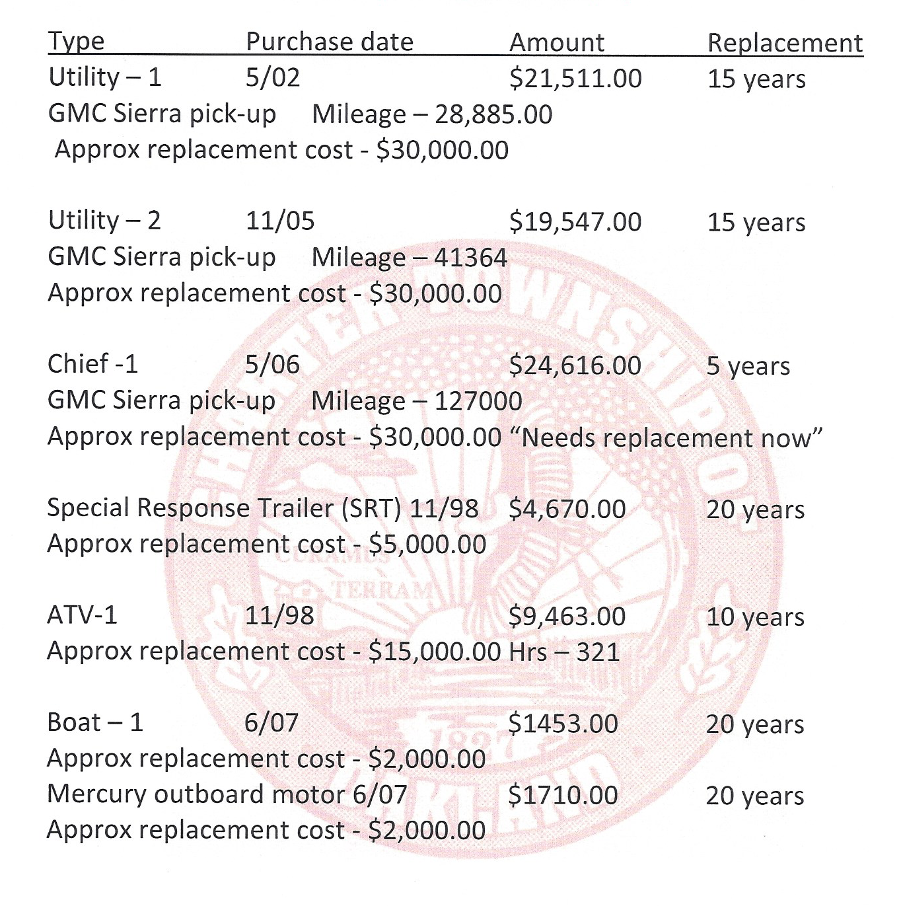
OTFD Fixed Assets

Slide 71
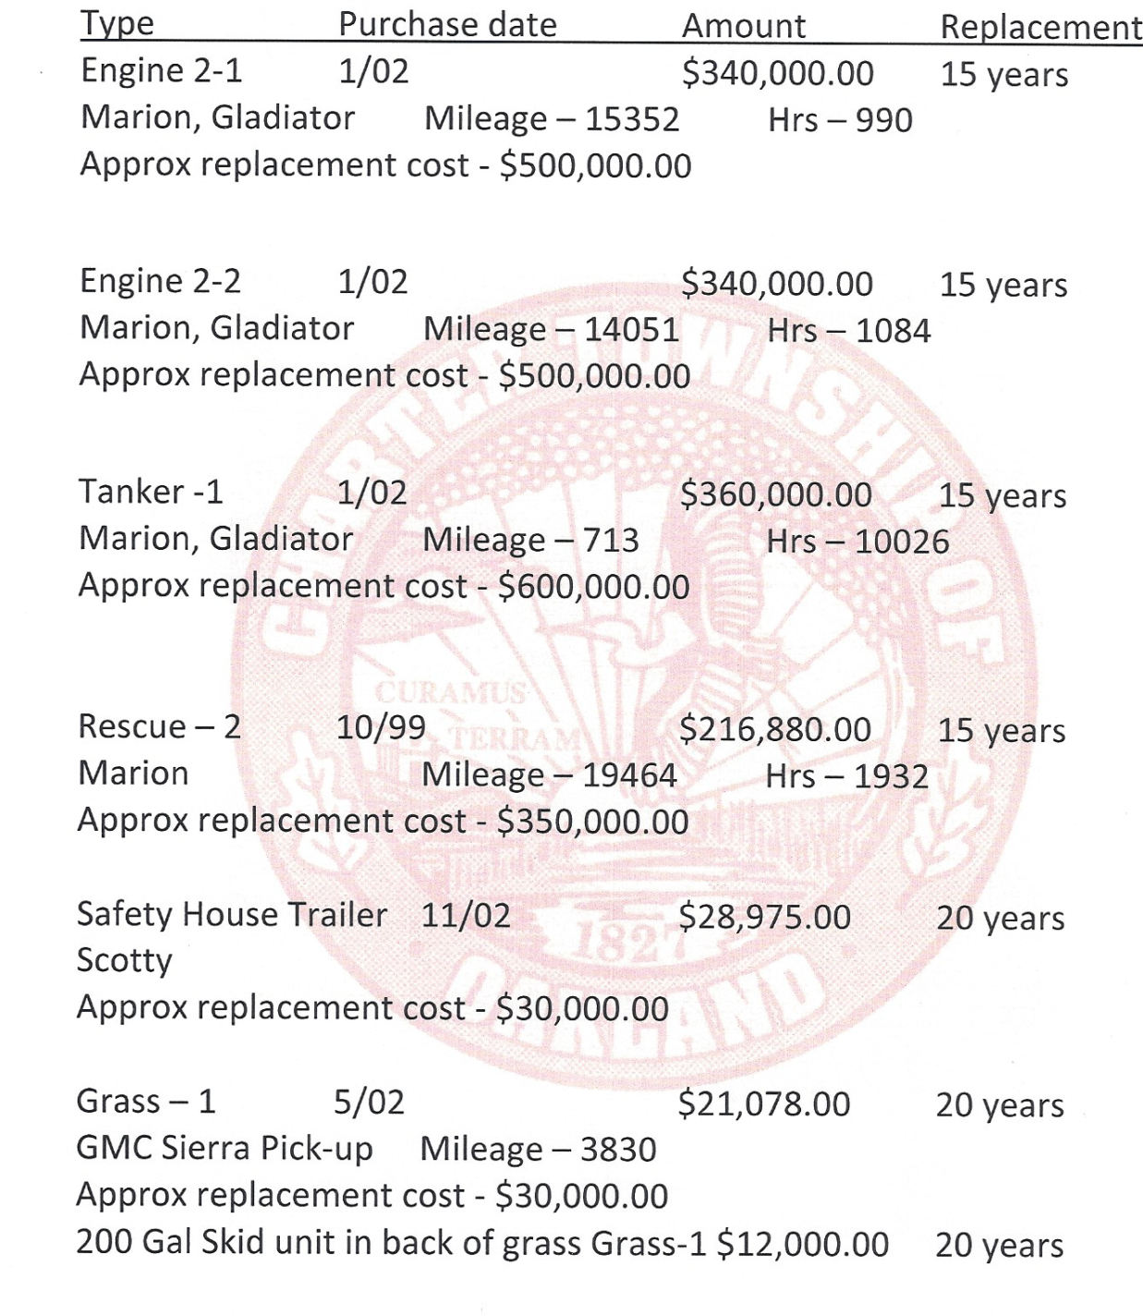
OTFD Fixed Assets

Slide 72
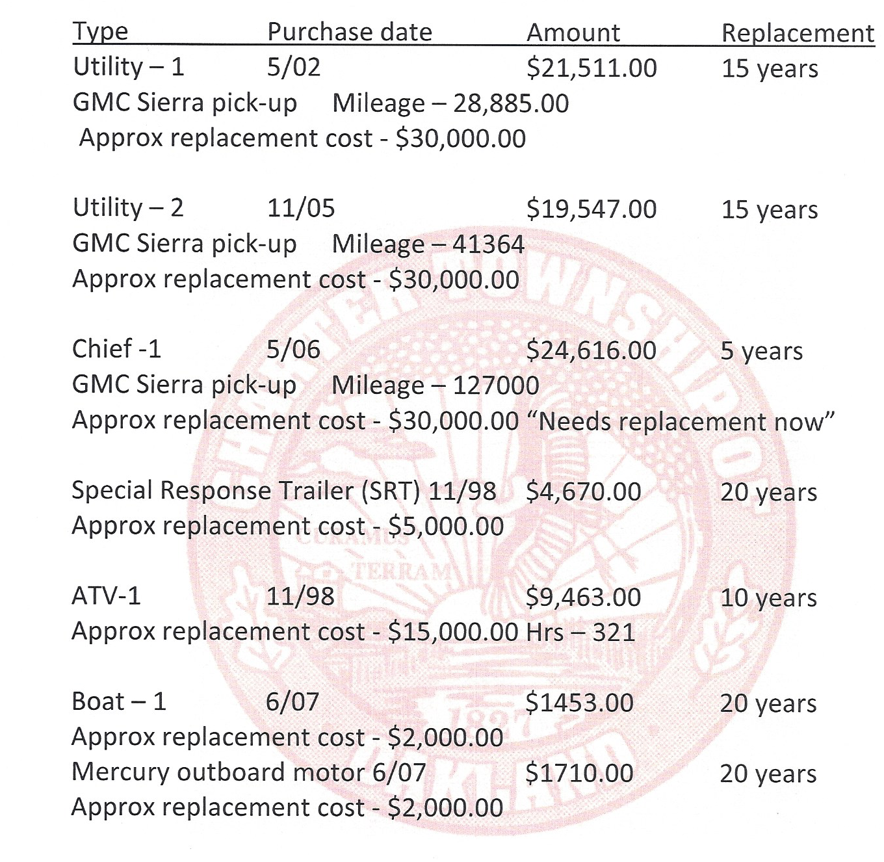
OTFD Fixed Assets

Slide 73
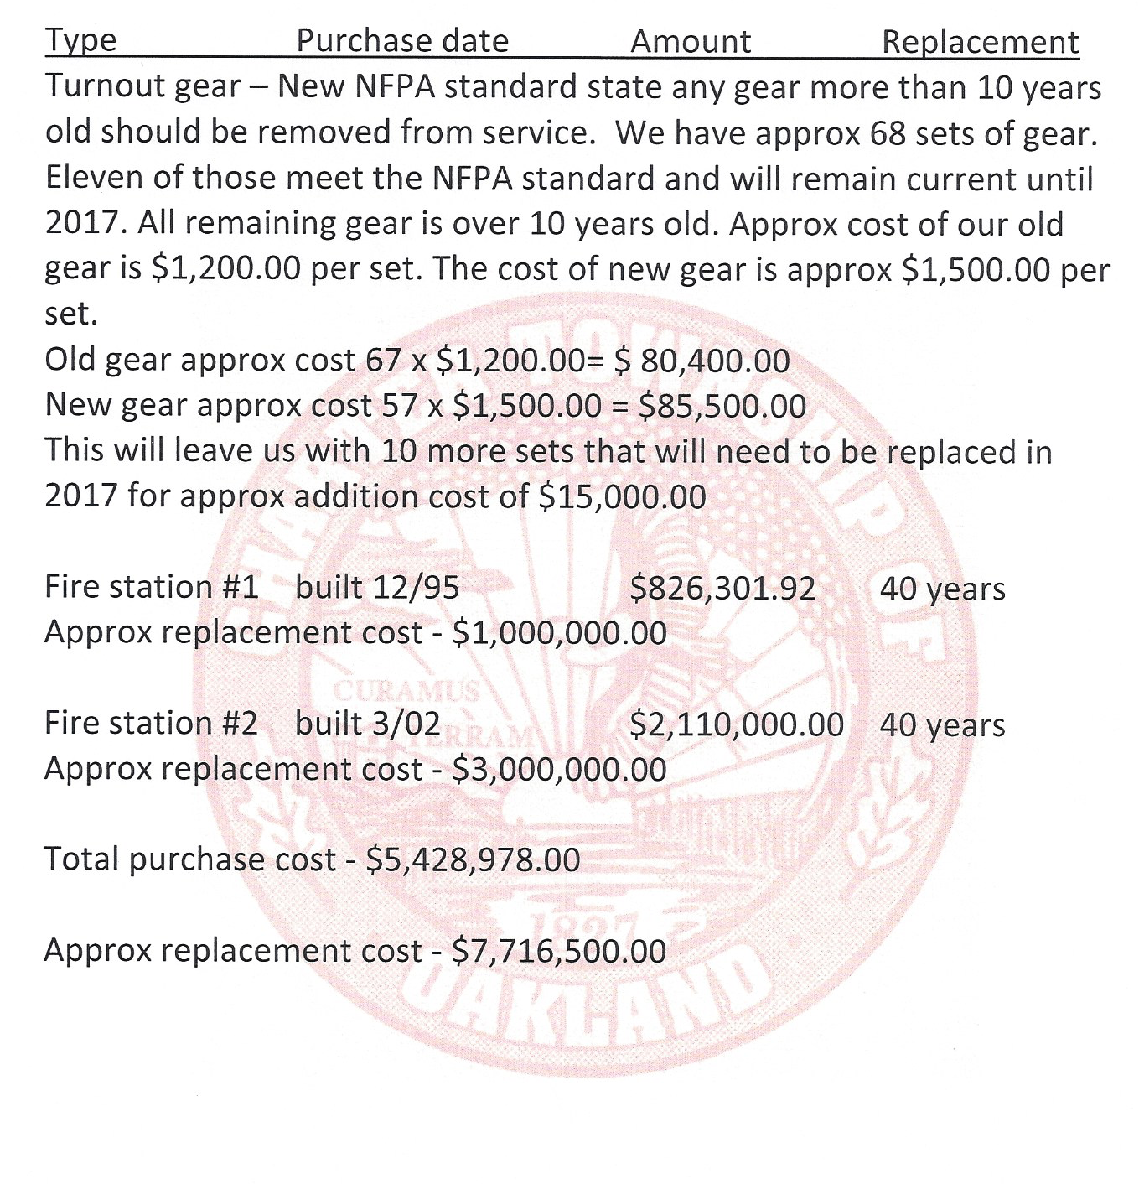
OTFD Fixed Assets

Slide 74
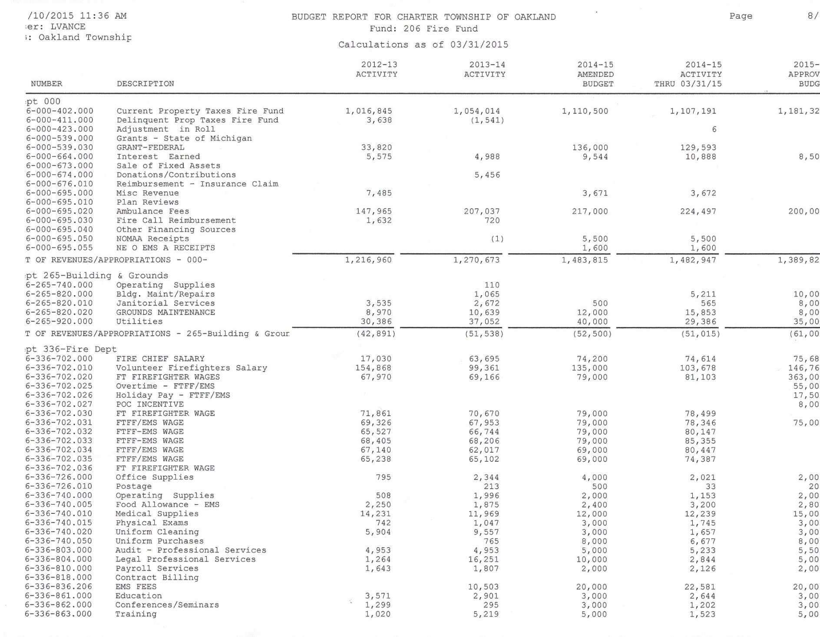

Slide 75
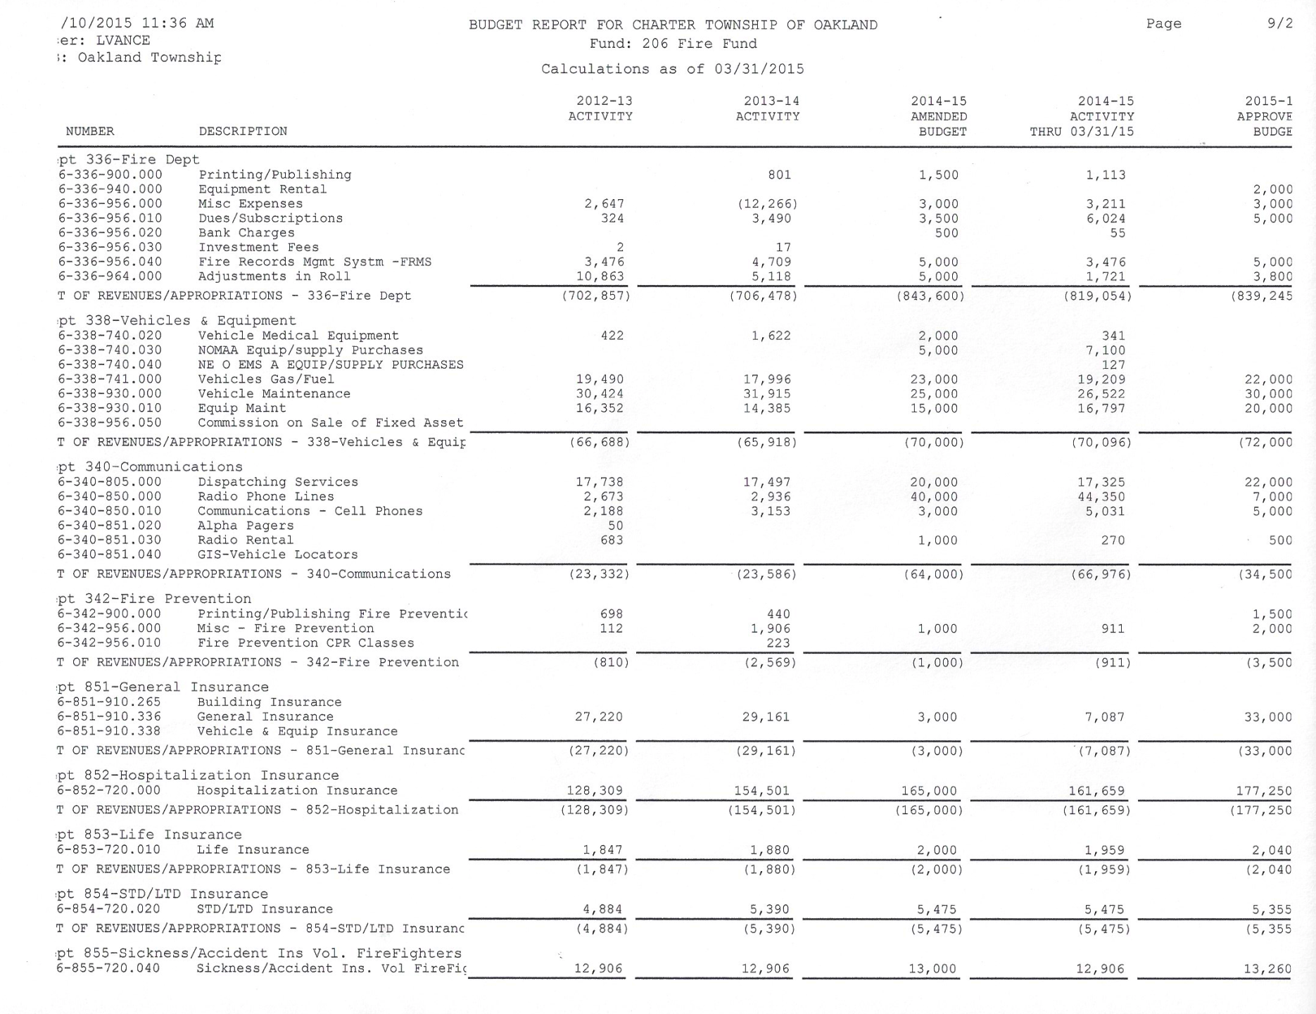

Slide 76
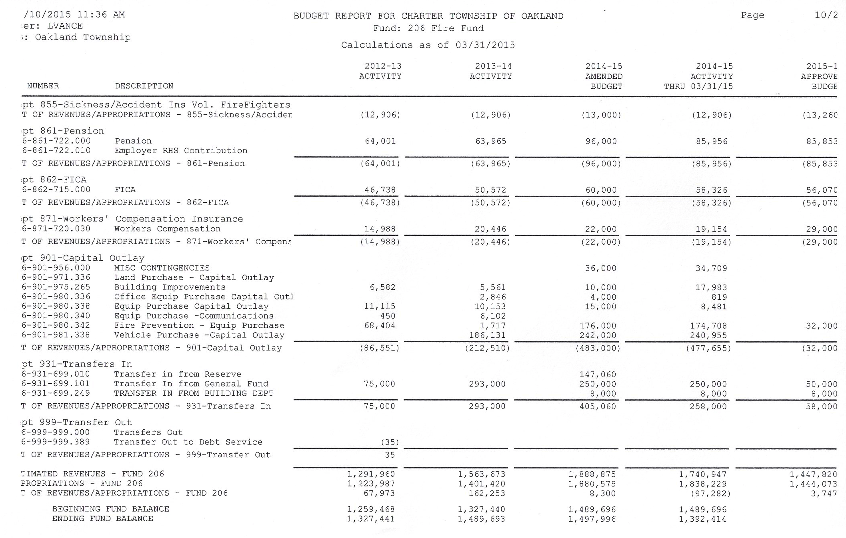

Slide 77
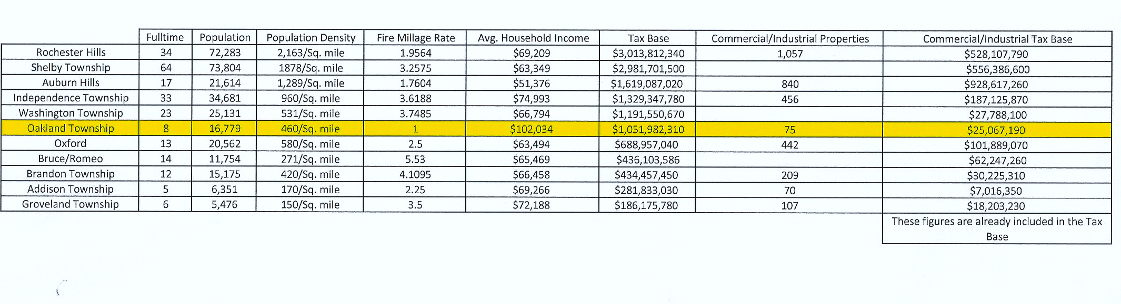
Comparison of Local Municipal Fire Departments
Tax Base

Slide 78
Other Data

