Slide 1
Oakland Township EMS Response Time
Importance of
monitoring 90% fractiles, not averages
correct definition of start and stop of clock

Slide 2
Definition of Response Time
No universally accepted national definition of clock start and stop (for example – see Houston)
Oakland County Medical Control Authority (OCMCA) Defines for OTFD in next slide in their Protocol 6-18, page 6. http://www.ocmca.org/wp-content/uploads/2016/08/6-18-EMS-Response-Time-Standards.pdf

Slide 3
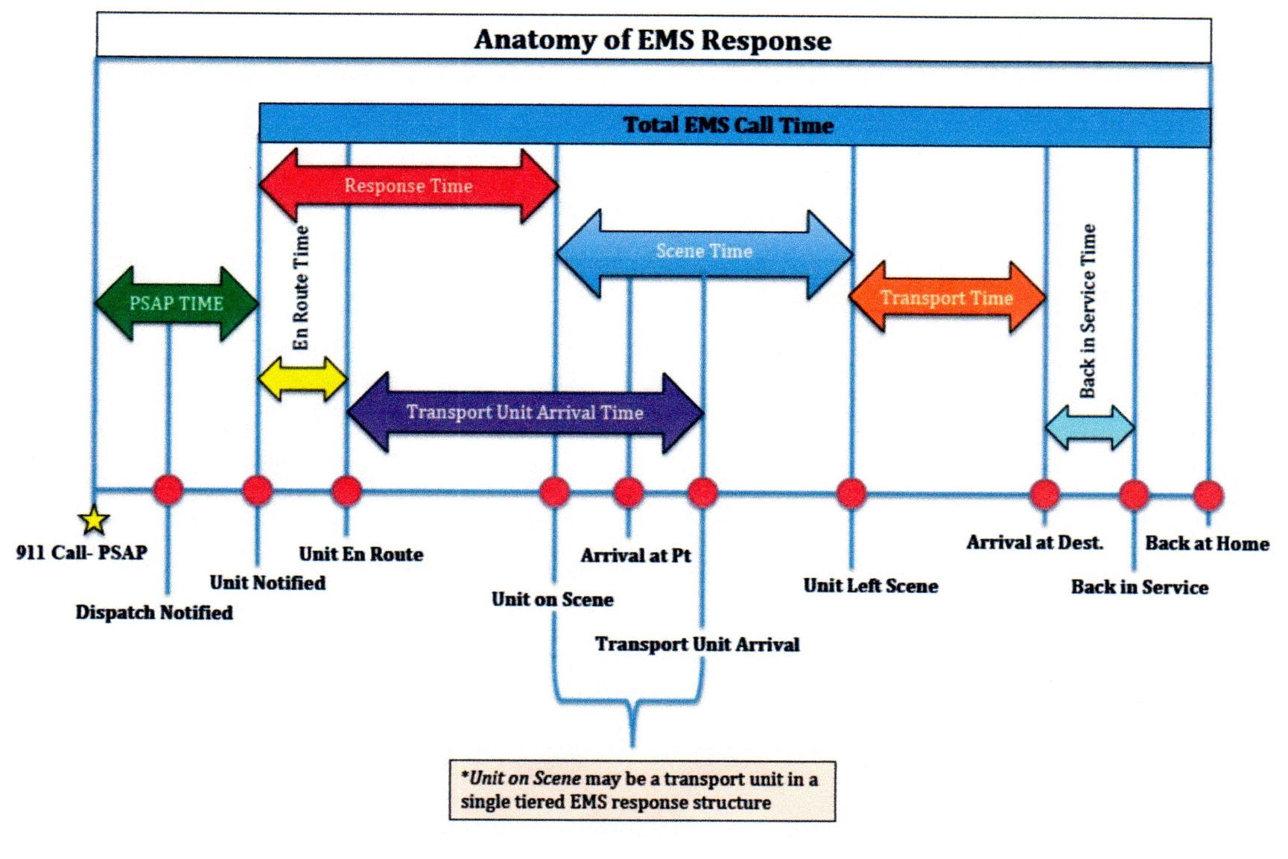
OCMCA Response Time Definition – (we should track red arrow)

Slide 4
Why Pay Attention To OCMCA?
OTFD is a Life Support Agency licensed to provide specific medical services by OCMCA under State Law Act 368 of 1978
Must meet OCMCA requirements to stay licensed. See OCMCA Protocol 6-1 for details of obtaining and keeping our license.
http://www.ocmca.org/wp-content/uploads/2016/08/6-1-Agency-and-EMS-Personnel-Criteria-for-Participation.pdf

Slide 5
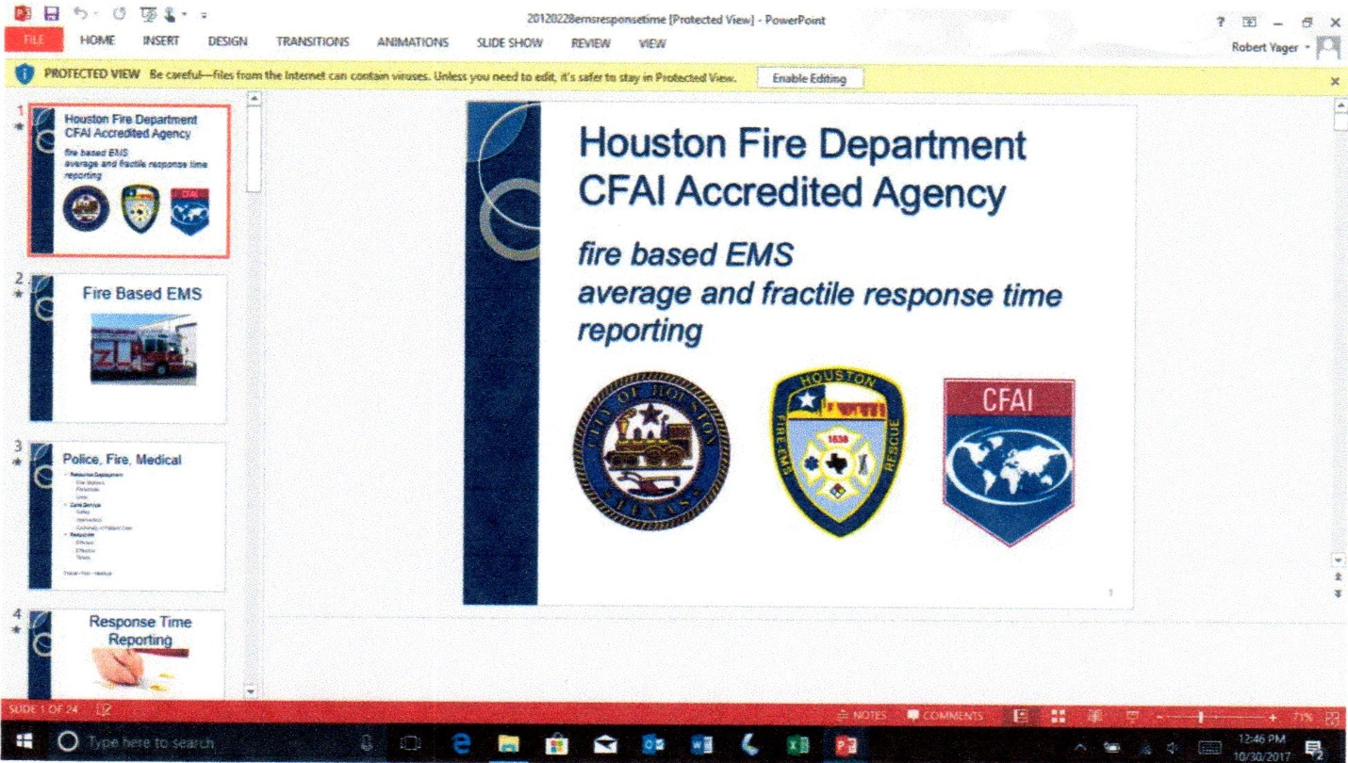
Houston Fire Dept. Adopts 90% Fractile

Slide 6
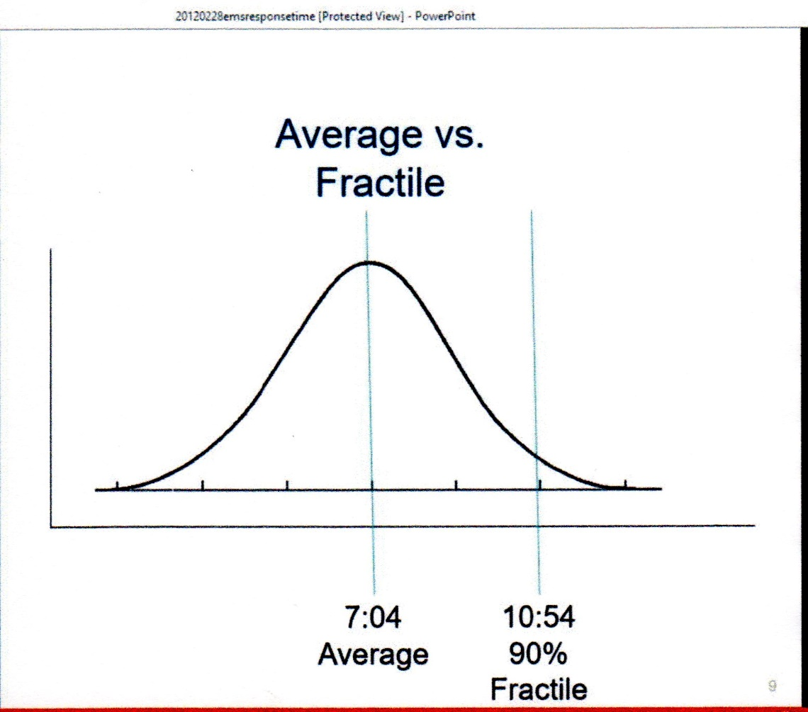
City of Houston Texas EMS Response Times – includes what OCMCA calls PSAP time (green bar on slide 3) http://www.slideserve.com/alexa-brooks/fire-based-ems

Slide 7

OTFD & Houston Response Time Component Definitions (we incorrectly track the blue arrow)
OTFD Response Time as we now calculate
Houston Fire Dept Response Time
First OTFD person on scene with a radio

Slide 8
Average OTFD EMS Response Time
(6.8 minutes) (period 10/13/16-10/13/17)
Data from 10/13/17 two page report “Average Response Time by to Section and Incident Type”. (Email D. Stuart to R. Yager 10/25/17)

Slide 9
Conclusions
We need to know, track and make public proper OCMCA EMS response time 90% fractile data.
To do that we need to calculate individual response times correctly and analyze all data.
I’d be glad to help and have FOIA’d some data on an OTFD experiment from late 2015 to early 2016. This data has both current incorrect OTFD method data and correct OCMCA method.

Slide 10
What slows OTFD response time?
Multitasking by lone ambulance driver slows safe driving speed
  Research route to address
  Watch for traffic
  Additional instructions from dispatch or Crittenton, en-route
Unit on scene requires both OTFD ambulances A-1 and A-2 to arrive on scene to achieve legal necessary min. manpower of 2 paramedic or 1 paramedic / 1 EMT.
Condition of Gallagher and Silverbell roads.
Lack of visible address markers, especially in condominiums

